Slide 1
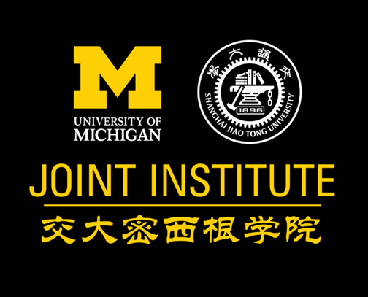
Art Apologist Presentation
VR251 Aesthetics
Group 3 Blank
Chongdan Pan
Notes:
Hi, everyone, I’m Chongdan Pan from Group 3 Blank, I’m going to argue that Traditional Chinese Medicine is an art.

Slide 2
Introduction
Traditional Chinese Medicine (TCM)
vs.
Western Medicine
Originate from Chinese Philosophy
Qualitative
Originate from Chemical Science
Quantitive
Notes:
Traditional Chinese medicine, is also known as TCM, originated from Chinese philosophy, which considers human body a part of nature. Both the universe and human body is composed of constantly changing abstract elements. However, western medicine is from chemical science. Therefore, western relies much on data, while TCM is qualitative.

Slide 3
Neglect of TCM’s Art
Weak Influence
Lack of deep understanding
Hospital in China
Notes:
But why we neglect TCM? The left graph shows the hospital distribution in China. Even in the origin there are far more western medicine hospitals than TCM. So our conventional perception to medicine is majorly formed by the western medicine and science. The original work of TCM is another barrier to our understanding for TCM, because they’re difficult to read.

Slide 4
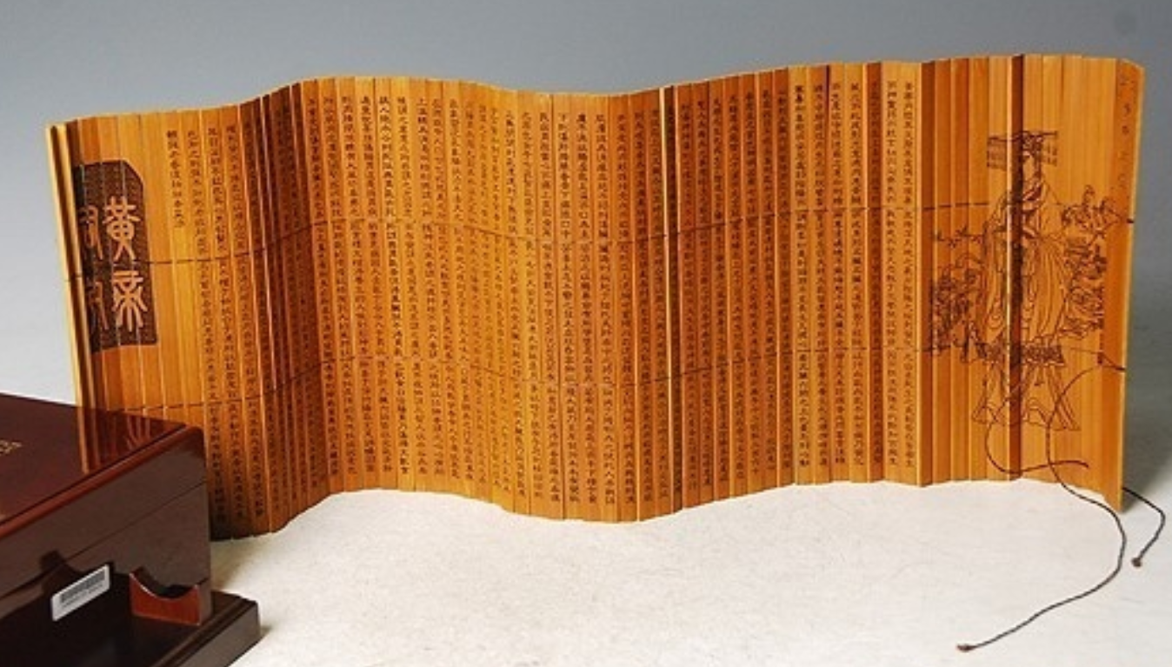
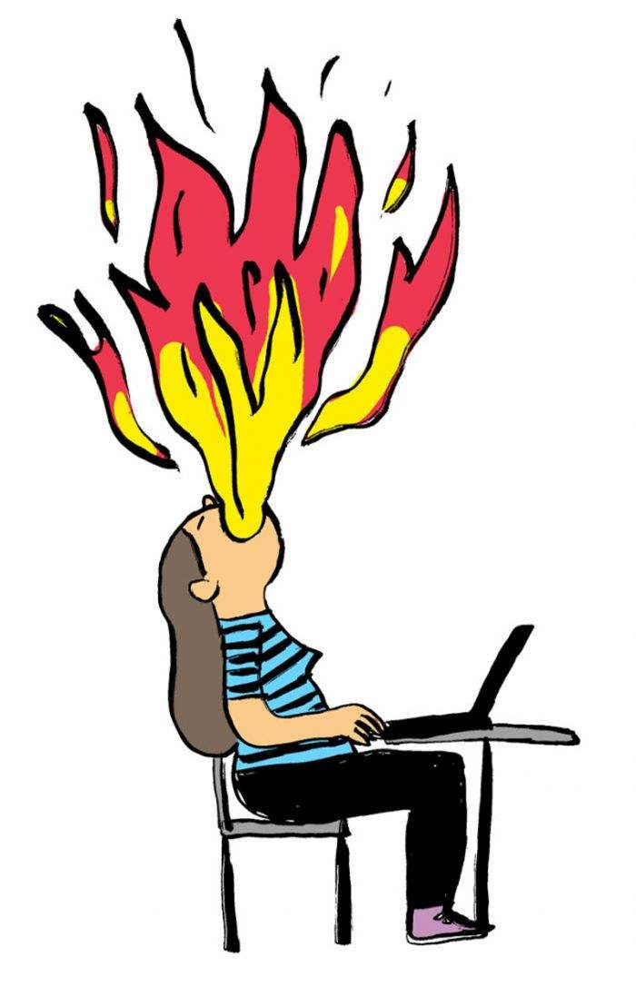
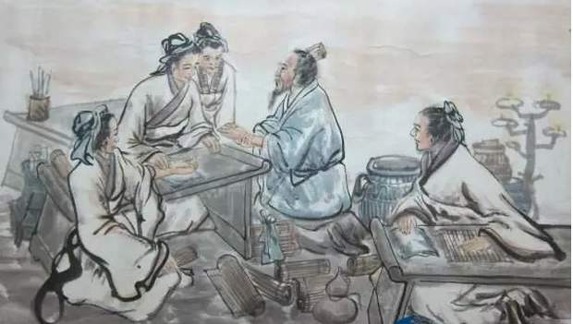
TCM’s Art in Literature
Rhythmic words
On Fire
Legendary doctors
Notes:
But we can find art in its difficult literature. Huangdi Neijing is considered as the ancestor of TCM. Different from common science book, its words has neat and balanced form, melodious and harmonious rhythm, making it more like a literary and artistic work. In addition, there many legendary doctors with mythical stories in the TCM’s history, for example, Hua Tuo and Bian Que, are commonly believed as miracle-working doctor, who can treat any disease with mysterious prescription. No matter whether these stories are true, they can arouse our curiosity as well as exclamation. Artistic expression is also widely used terminology. For example, the word 上火, which is on fire in English, can be used to describe symptoms like inflammation in TCM. Although our body can’t actually burn inside, word “on fire” can express our feeling vividly when we have physical pain inside.

Slide 5
TCM’s Art in Philosophy
Nature, Human
Fire, Earth, Metal,
Water, Wood
Great artwork needs no work
Great medicine needs no medicine
Yin, Yang
Chi
Notes:
In TCM’s philosophy, it argues that, essentially everything is generated from the same abstract thing called chi. So it is designed to unify and explain the world and human in one principle. Therefore, TCM tends to use natural to treat against disease rather than synthetic polymers. Although TCM seldom depends on data, it can readily treat some chronic disease, which are extremely intractable for western medicine. There goes a saying “Great artwork needs no work”, perhaps TCM can be described as well ”Great medicine needs no medicine”.

Slide 6
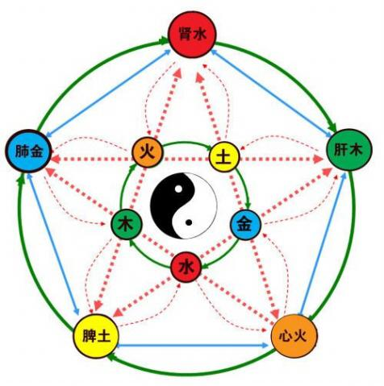
TCM’s Art in Philosophy
Harmony
Plurality
Experience
Imagination
YinYang and Five Elements
Notes:
The theory also states that everything is associated with interactions of five elements. The five elements are changing constantly and connected together, hence treatments in TCM philosophy also vary with each individual. For TCM doctors, they concentrate on using different ways to achieve balance and harmony of the five elements in human body, rather than treat specific disease. Therefore, TCM is plural in treatments, and the pursue for harmonious makes it more like an aesthetic experience. Due to plurality, treatment in TCM requires imagination as well as experience. With imagination and creation, TCM treatment is more like an art rather than a therapy.

Slide 7
Relation to our Reading
Neol Carroll ’s Philosophy of Art
Subject: Medicine
R.W. Hepburn’s Contemporary Aesthetics and the Neglect of Natural Beauty
Plurality & Unity
Comment: Chinese Philosophy
Frame
Uncertainty & Imagination
Notes:
We can also regard TCM as art through arguments from our readings. According to Neo Representation theory, TCM is an artwork, because it has an object, which is medicine, and it uses Chinese Philosophy express its opinion to medicine. In Hepburn’s article, he claims that aesthetics is at the point between plurality and unity, which are both contained in TCM’s philosophy. Besides, TCM is like a combination of natural beauty and normal artworks. For normal people, its complexity and mystique build a frame like artwork, while for doctors, TCM has beauty like nature, due to its uncertainty and requirement for imagination in practice.

Slide 8
Q&A

Slide 9
Thank you

Slide 10
Reference
1. Raphals, Lisa. Chinese philosophy and Chinese medicine. The Stanford Encyclopedia of Philosophy. 2017 https://plato.stanford.edu/archives/fall2017/entries/chinese-phil-medicine
2. Noël Carroll: Philosophy of art, A contemporary introduction, Routledge 1999[J]. British journal of aesthetics, 2002, 42(2):211-214.
3. Hepburn, R.W. Contemporary aesthetics and the neglect of natural beauty. British Analytical Philosophy. 1996

